Slide 1

Large Scale Urban Ambient Noise Map
M. Billen; T. Hauschild
Notes:
Good day dear ladies and gentlemen,
We are pleased to welcome you today to the important topic of how we can measure and evaluate ambient noise quickly and in detail in the future. This is an important topic, both for the residents, their quality of life, as well as for employers, investors, urban planners and so on. Because noise affects all these people, whether in their leisure time, at work or on the way there. It is important for planning future buildings and projects. In addition, a good and regular measurement of the noise level can be used to analyze whether and which measures reduce noise and how successfully.
The EU directives require that in agglomerations with more than 100,000 inhabitants, major roads, airports and railroad lines must have their noise levels recorded and published every 5 years. However, it should not only be seen as a "must", but as a way to improve the quality of life of residents, workers and tourists. A happy city is also a happy, well-rested, creative and productive city.
Therefore, regular measurement and evaluation of the noise level should be carried out and measures against noise should be taken.
Today we want to give you a tool to be able to do this in the future.
At the beginning we will show you the current status and compare it with our solution. We will also go into the technical details and show you why our innovative solution is promising.

Slide 2
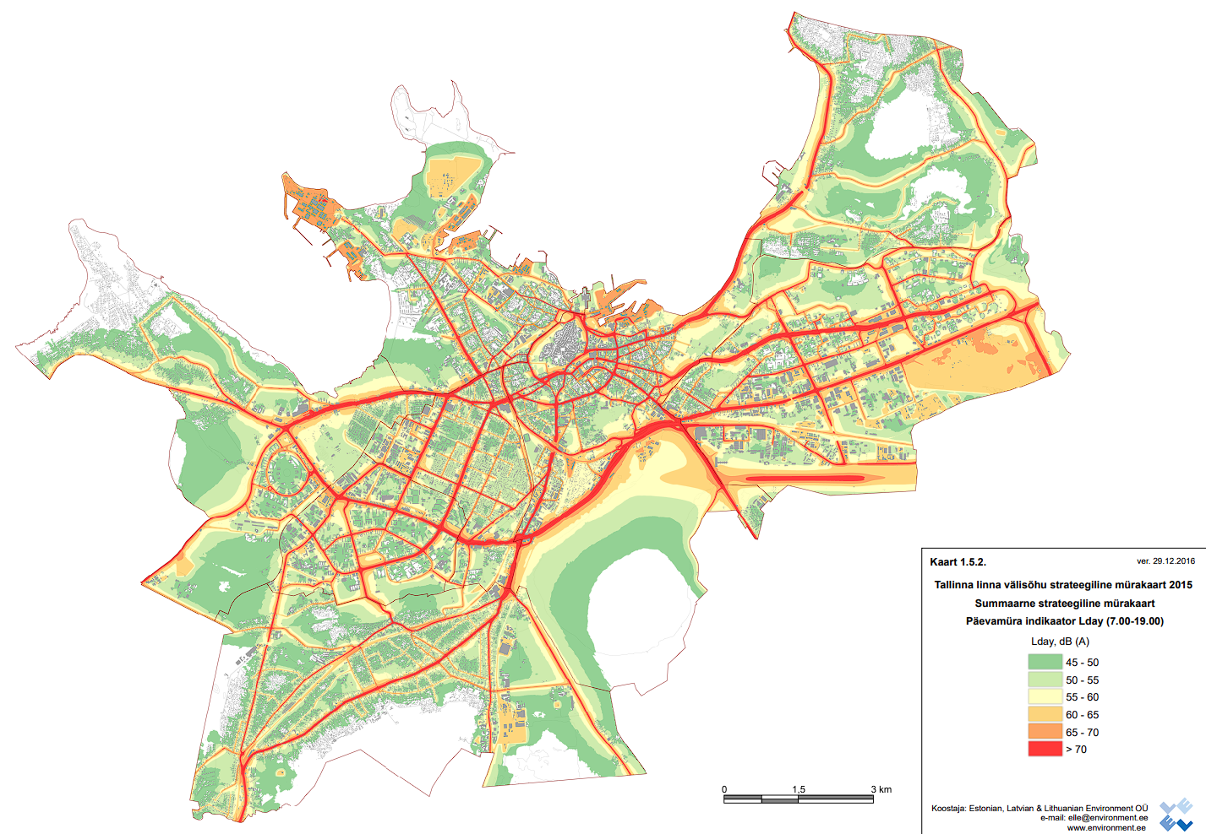

Notes:
Here we see one of the noise maps produced annually in the form of a heat map. This is created with the Smart City Sensor Network with sensor data from 07-19 clock from 29.12.2016. It can be seen that especially on the main roads, industrial area and near the airport a lot of noise arises.
--Nicht geeignet für Rot Grün Schwäche

Slide 3
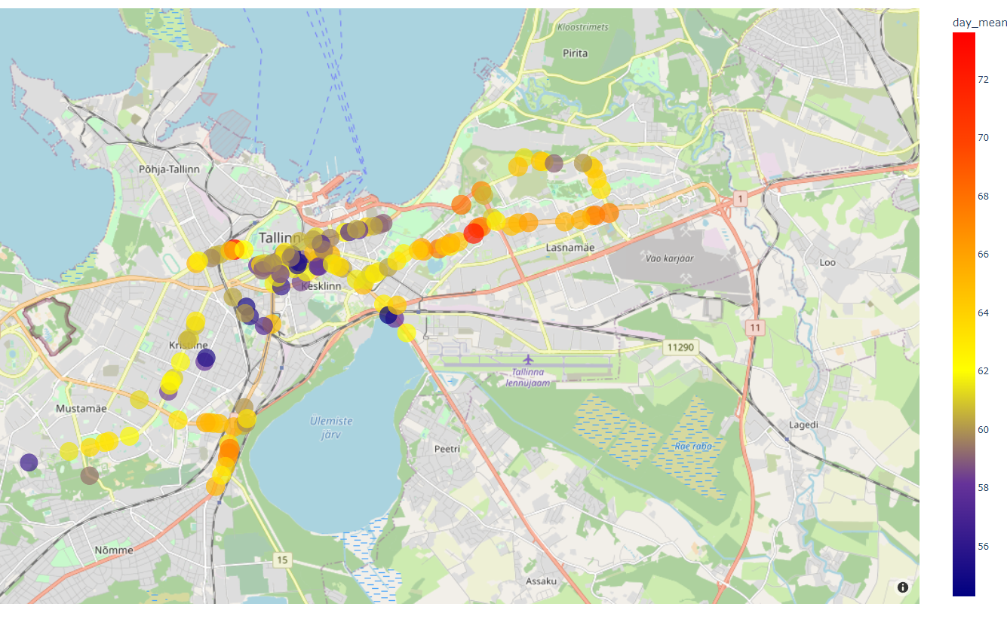
Notes:
And now for our solution. For example, here we see the sensor locations provided to us. The different colors show the average values of the volume at the same time period as in the previous map. Here you can see especially well the different noise levels, even though a heatmap has not even been created from it.
As in the previous map, the areas near the main roads are particularly noisy. In addition, an increased noise level near the Tondiraba industrial area can be seen very well. Unfortunately, we were not sent sensor data from Peterburi Street, the airport, the ports and the Betooni and Suur-Sojamäe industrial parks. These areas have increased loudness as shown on the annual map and we would have liked to compare these areas. Nevertheless, we could make some interesting observations. Firstly, that there is usually less noise at intersections (probably because there is often stopped by the traffic lights and overall slower driving), the east is altogether louder and near the old town and on side streets it is quieter. An interesting point is the dark red dot on the left. Next to it are averages in the lower and middle ranges, so why is the loudest average there? A little trip on Google Street View tells us: a kindergarten and a playground are nearby.

Slide 4
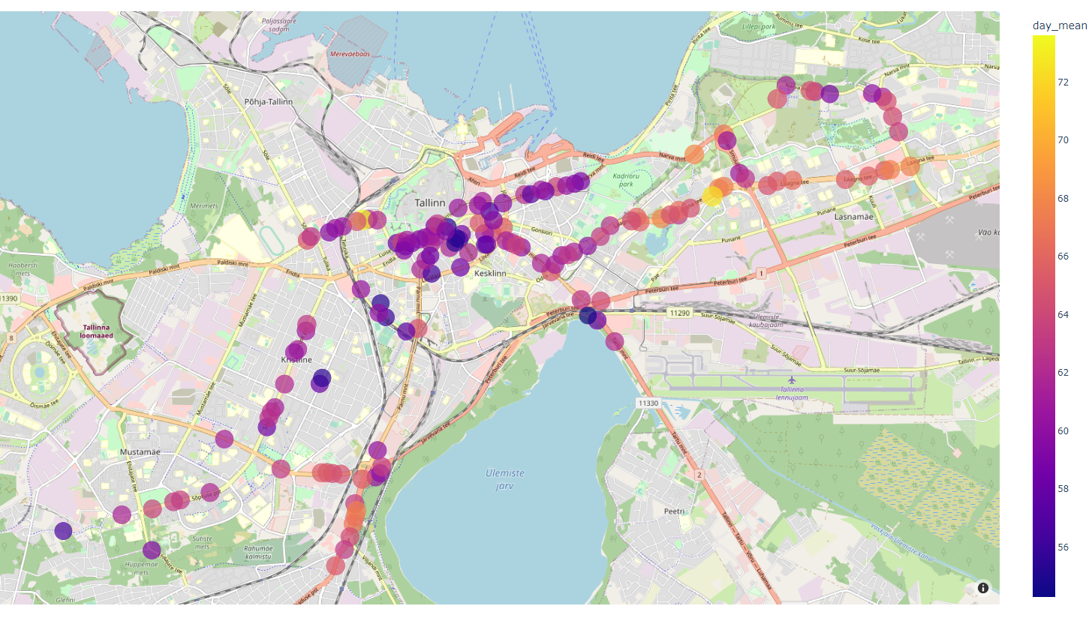
Notes:
Auch in rot grün Schwäche möglich

Slide 5
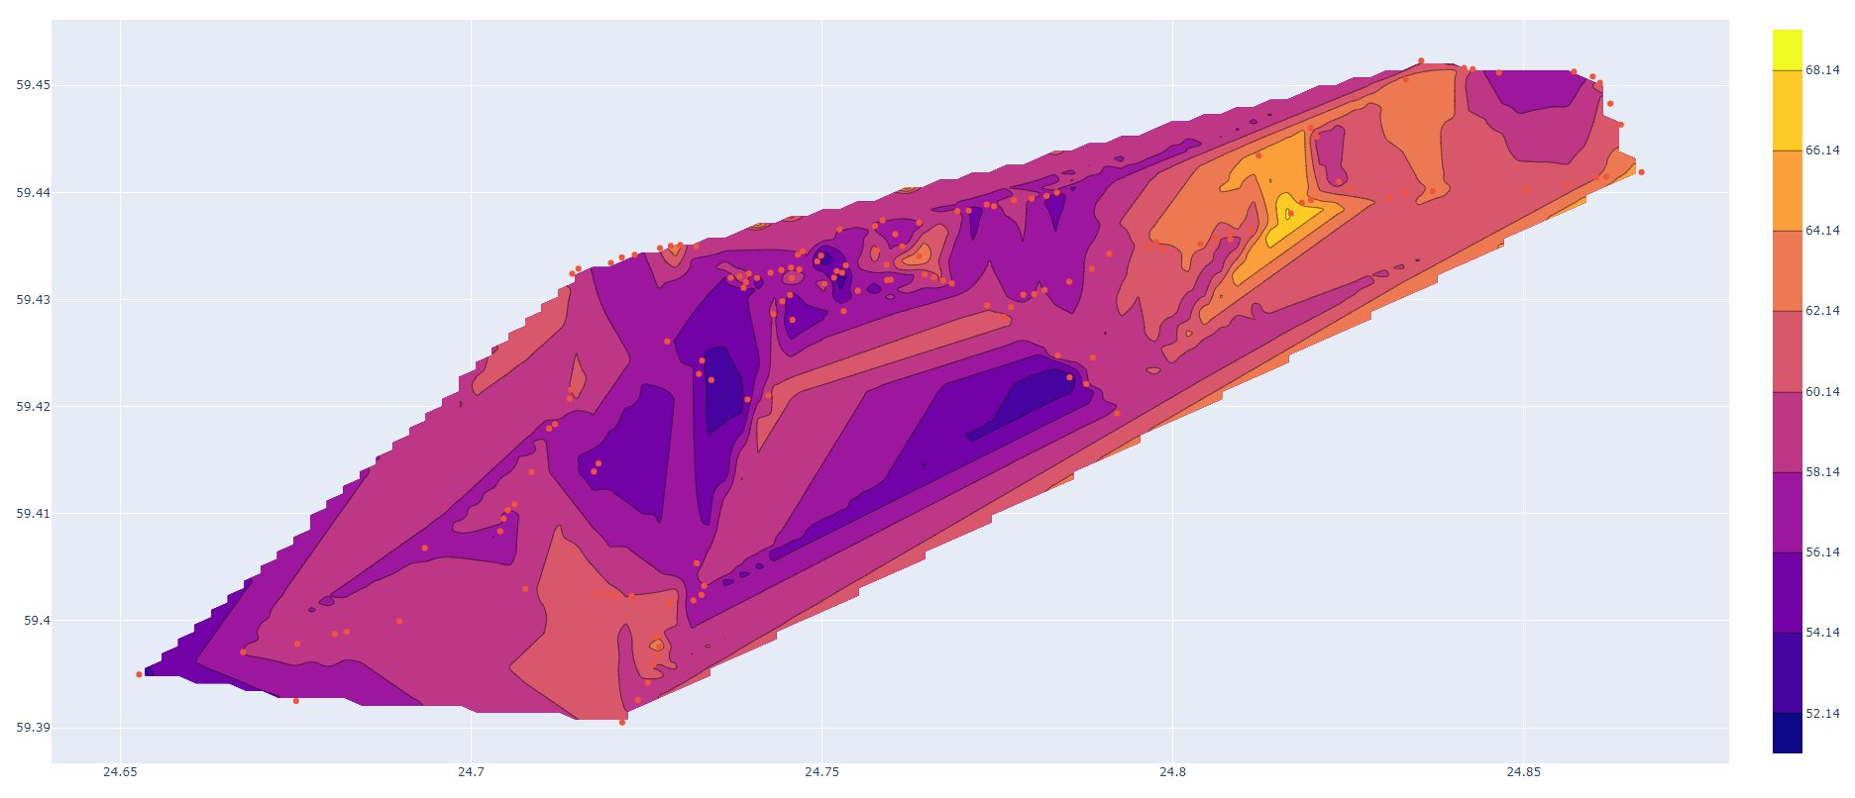
Notes:
Karte hinterlegen

Slide 6
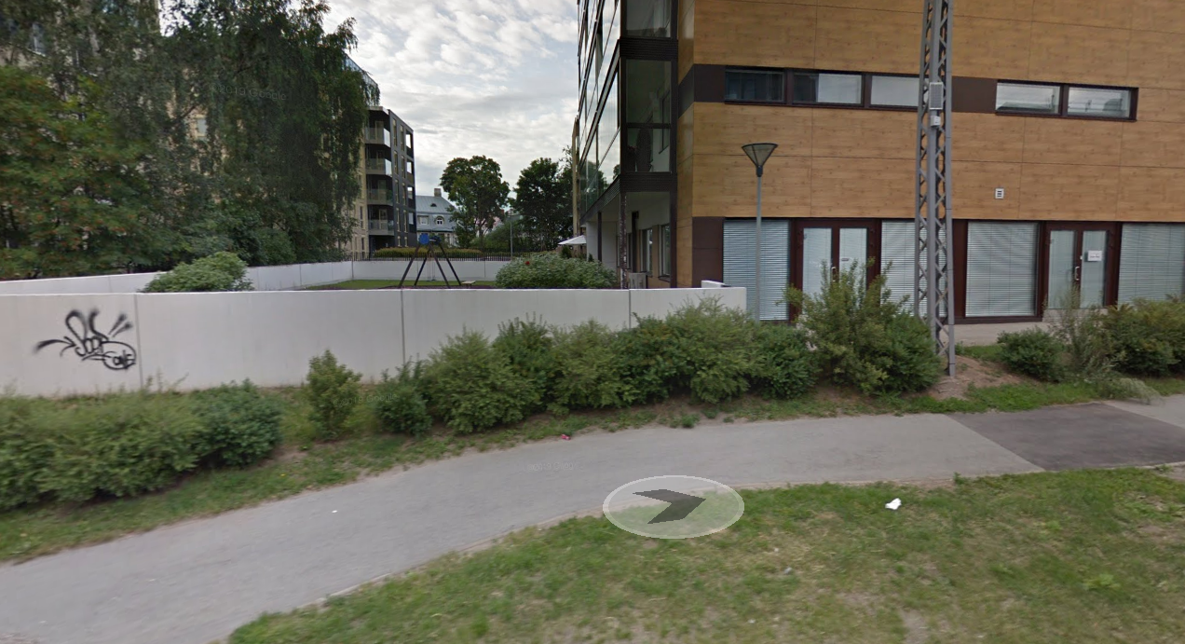
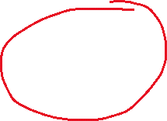
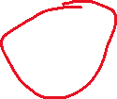

Slide 7
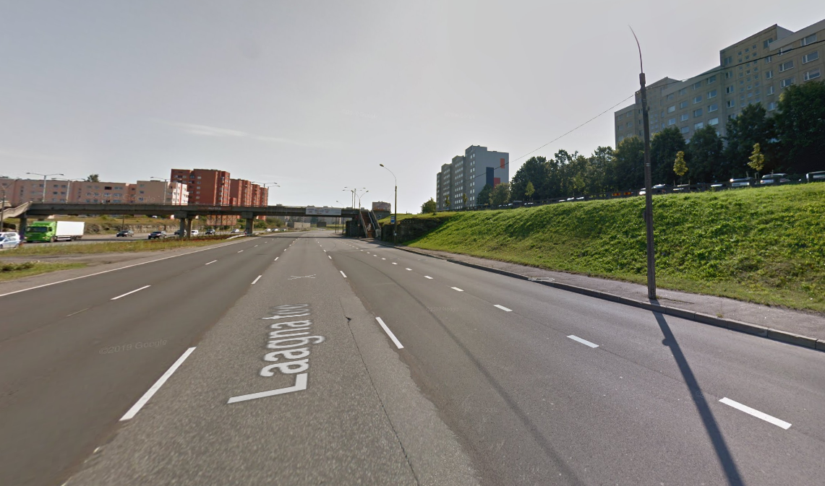
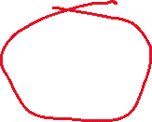

Slide 8
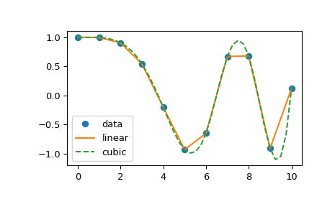
Interpolation
Linear
Time
Cubic
Notes:
Now to the technical details. There were of course a few problems with the sensor data provided to us. Some sensors did not provide any values, sometimes there were several different values at the same time from the same sensor, often there are gaps between transmitted values. Therefore, we have to clean up the data and adapt it for our purposes. This is where interpolation helped us. There are different types of interpolation, but well suited for our purposes are 3 different types that I would like to introduce briefly. Linear interpolation is the simplest and fastest, but it has the problem that it creates a kink at a new x value, which can lead to problems when used further, especially if derivatives are to be used. The Cubic variant should be used for this. Polynomial functions are created between the x values, which leads to a smoother graph that can also be used for higher derivative calculations. However, "overshoots" occur, i.e. higher values than are actually measured. This can lead to problems if certain threshold values are not to be exceeded.Therefore, we decided to use the interpolation type "Time". This is similar to linear, but the values are additionally set in relation to the points in time. If a value is missing and the associated timestamp is closer to another complete measurement, the interpolated value nestles against that of the measurement closer in time.As described, these 3 variants have their advantages and disadvantages, which is why they should be adapted for the specific purpose. However, this is very simple in our solution, only one variable needs to be changed.Translated with www.DeepL.com/Translator (free version)

Slide 9
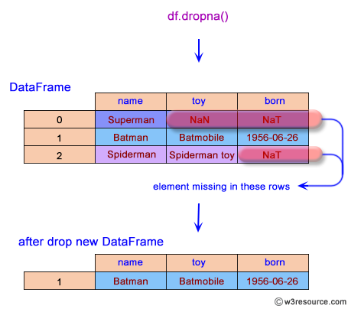
Alternatives
Drop
Fill
Other Data
Notes:
Alternatively, drop, fill and other data can be used. With Drop, incomplete data is deleted. This means that only complete "good" data is used. However, this results in conspicuous jumps that would have to be examined each time.
Fillna is better. Here, the missing values are filled with previous, subsequent or averaged values. This is better than dropna, but still results in kinks and jumps.
It would be far better to use missing values with values from other sensors from a similar area. However, this would require a sufficient number of sensors to be set up and maintained in the same area, which would lead to increased costs.

Slide 10
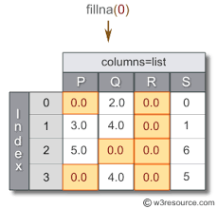
Alternatives
Drop
Fill
Other Data
Notes:
Alternatively, drop, fill and other data can be used. With Drop, incomplete data is deleted. This means that only complete "good" data is used. However, this results in conspicuous jumps that would have to be examined each time.
Fillna is better. Here, the missing values are filled with previous, subsequent or averaged values. This is better than dropna, but still results in kinks and jumps.
It would be far better to use missing values with values from other sensors from a similar area. However, this would require a sufficient number of sensors to be set up and maintained in the same area, which would lead to increased costs.

Slide 11
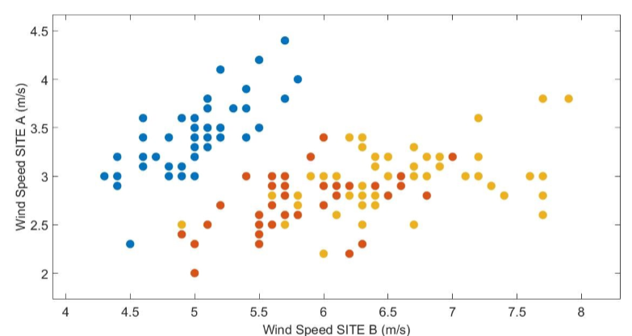
Alternatives
Drop
Fill
Other Data
Notes:
Alternatively, drop, fill and other data can be used. With Drop, incomplete data is deleted. This means that only complete "good" data is used. However, this results in conspicuous jumps that would have to be examined each time.
Fillna is better. Here, the missing values are filled with previous, subsequent or averaged values. This is better than dropna, but still results in kinks and jumps.
It would be far better to use missing values with values from other sensors from a similar area. However, this would require a sufficient number of sensors to be set up and maintained in the same area, which would lead to increased costs.

Slide 12
SVD
All
Depends
Notes:
all, warum?Weil es möglich ist. Um Daten zu sparen /Daten schneller auszuwerten sollte ein niedriger Rang verwendet werden.
RMSE² < 1dB = ?th rank

